Slide 1
Syntax and Semantics
6/19/2023

Slide 2
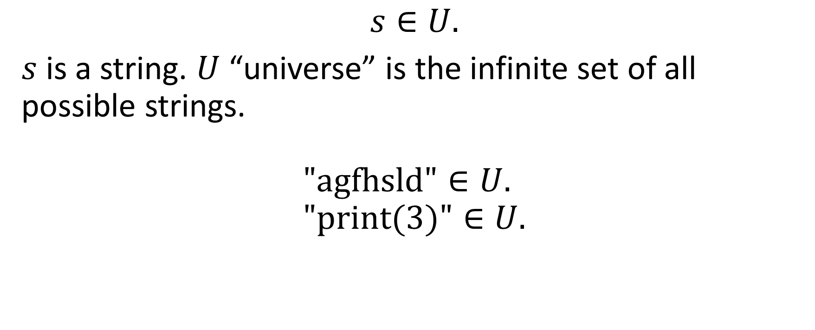
String
$$s∈U.$$
$s$ is a string. $U$ “universe” is the infinite set of all possible strings.
$$\text{"}\text{agfhsld}\text{"}∈U. \\ "\text{print}\text{(3)}"∈U.$$

Slide 3
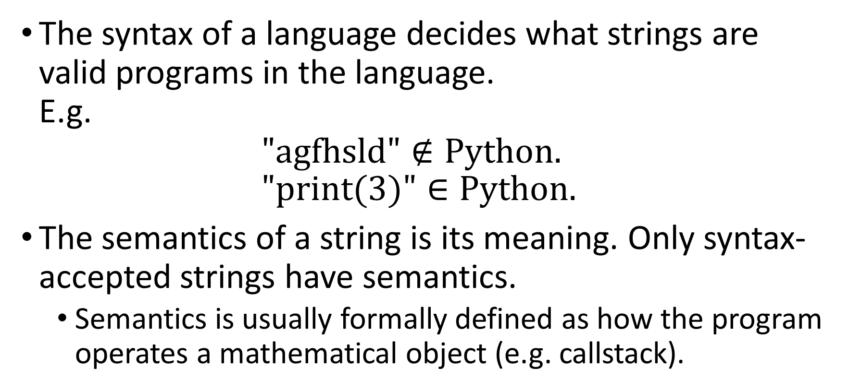
Syntax and semantics
The syntax of a language decides what strings are valid programs in the language. E.g. $\text{"}\text{agfhsld}\text{"}∉Python.$ $"\text{print}\text{(3)"}∈Python.$
The semantics of a string is its meaning. Only syntax-accepted strings have semantics.
Semantics is usually formally defined as how the program operates a mathematical object (e.g. callstack).

Slide 4
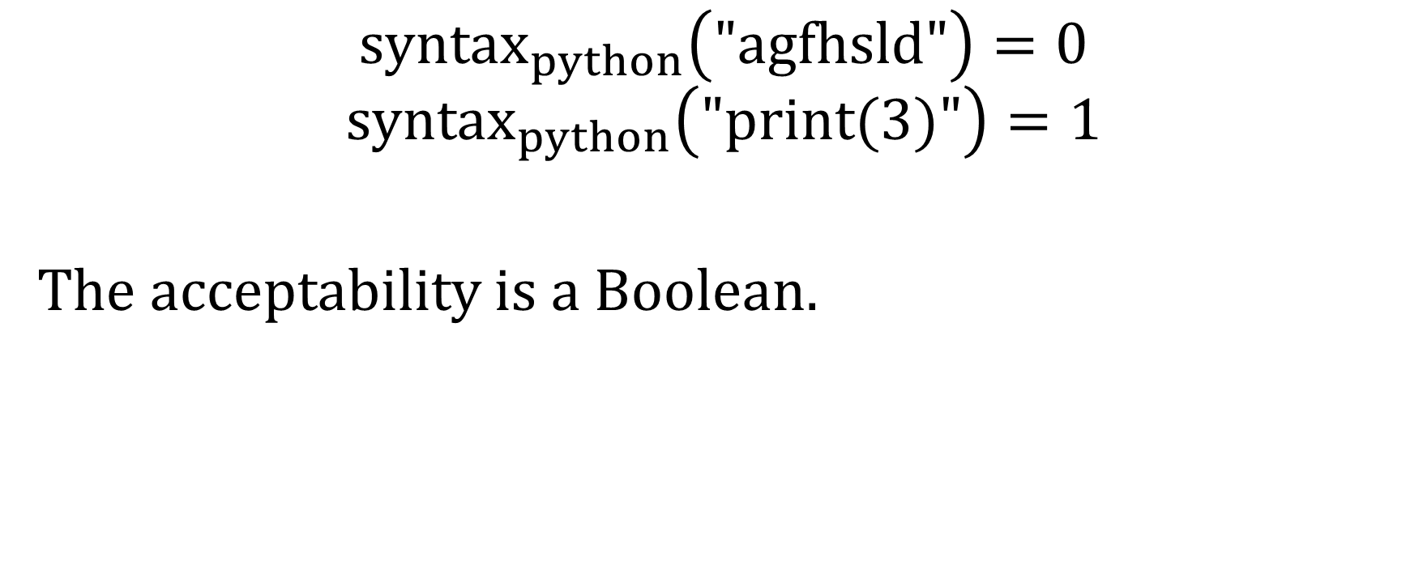
We have a computational definition of syntax and semantics of programming language.
$$syntax_{python}\left(\text{"}\text{agfhsld}\text{"}\right)=0$$
$$syntax_{python}\left(\text{"}\text{print}\text{(3)"}\right)=1$$
The acceptability is a Boolean.

Slide 5
We don’t have a computational definition of syntax and semantics of natural language.
Let’s guess an analogy.
“string acceptability”?

Slide 6
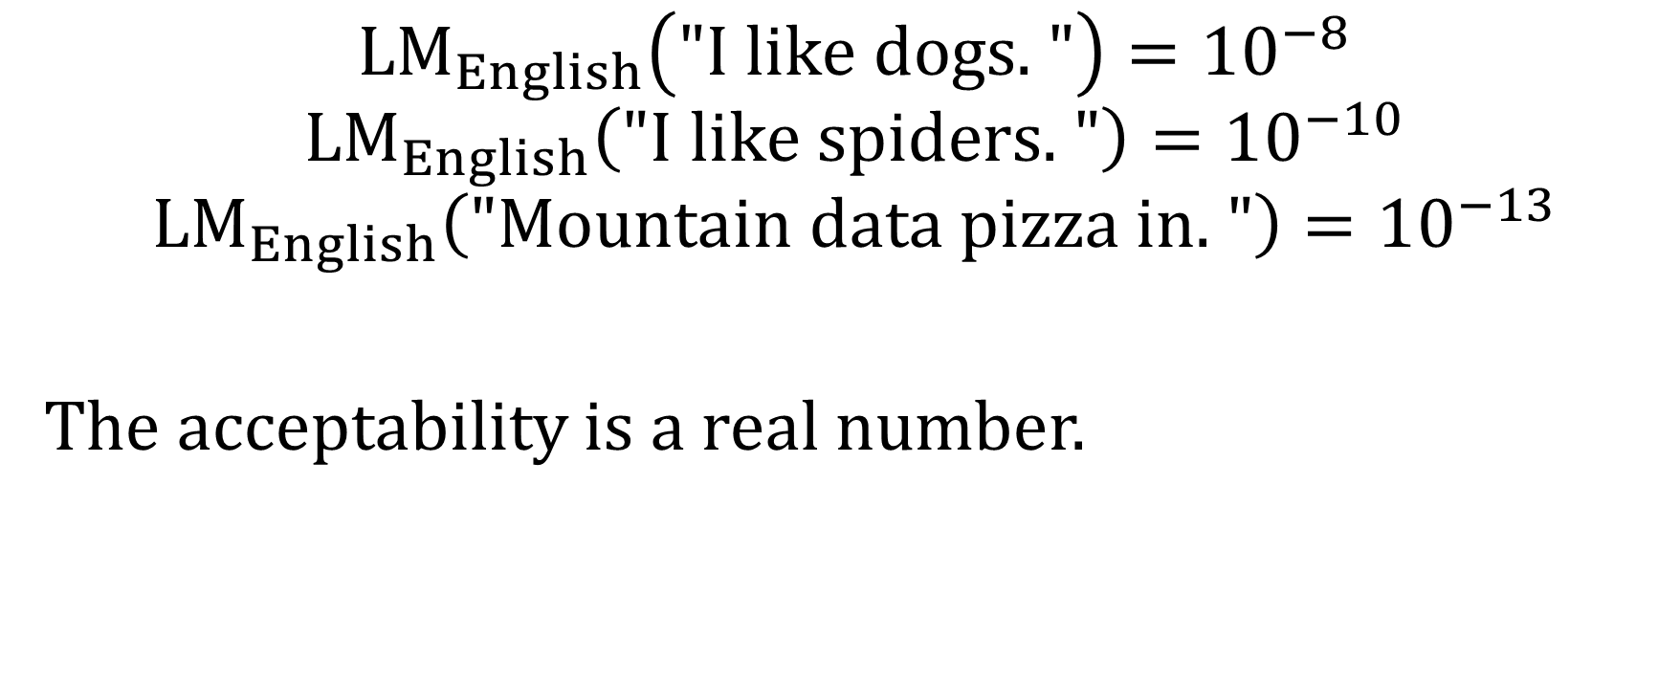
Each string has a likelihood in an LM.
$$LM_{English}\left(\text{"}\text{I} \text{like} \text{dogs}\text{. "}\right)={10}^{−8}$$
$$LM_{English}\left(\text{"}\text{I} \text{like} \text{spiders}\text{. "}\right)={10}^{−10}$$
$$LM_{English}\left(\text{"}\text{Mountain} \text{data} \text{pizza} \text{in}\text{. "}\right)={10}^{−13}$$
The acceptability is a real number.

Slide 7
Programming languages: syntax is the condition of semantics.
Natural languages: syntax contains semantics?
Imagine you are reading a dialog between Achilles and Crab. If I redact a sentence and tell you its likelihood value, then you have already gained some meaning.
Musical syntax contains semantics?

Slide 8
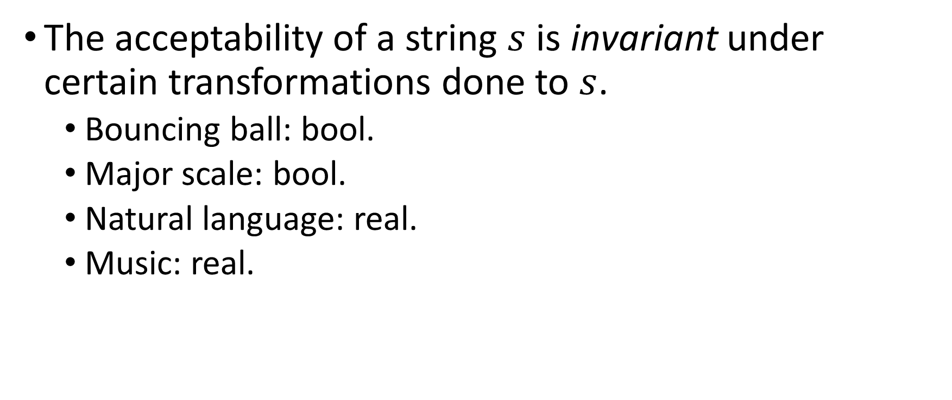
Symmetry
The acceptability of a string $s$ is invariant under certain transformations done to $s$.
Bouncing ball: bool.
Major scale: bool.
Natural language: real.
Music: real.

